Slide 1
Java Servlet
Dr. Rajeshree Khande,
Associate Head, School of Computer Science,
MIT-World Peace University

Slide 2
Retrieve Client Input Data in Servlet
When client send some input data to the servlet, that data will be available in the form of request object.
We can retrieve that input data through HttpServletRequest or ServletRequest interface.
4 methods to retrieve the client data which is present in request object.
All these methods are present in javax.servlet.ServletRequest interface, and HttpServletRequest is the sub interface of ServletRequest,

Slide 3
Retrieve Client Input Data in Servlet
public String getParameter(“input variable”);
public Enumeration getParameterNames();
public Map getParameterMap();
returns the value of the given parameter.
Returns an Enumeration of String objects containing the names of the parameters contained in this request
always returns Map object. Returns input parameter names and their values in the form of key and value pairs

Slide 4
Example : getParameter()
index.html
<HTML>
<HEAD><TITLE>Form Servlet</TITLE></HEAD>
<BODY>
<FORM METHOD = GET ACTION= "http://localhost:8080/Project1/FormServlet">
Please Enter Your Name:
<INPUT TYPE = TEXT NAME = "name"><p>
<INPUT TYPE = SUBMIT>
</FORM>
</BODY></HTML>

Slide 5
Example : getParameter(): method returns the value of the given parameter.
FormServlet.java
import java.io.*;
import javax.servlet.*;
import javax.servlet.http.*;
public class FormServlet extends HttpServlet {
public void doGet(HttpServletRequest request, HttpServletResponse response) throws ServletException, IOException
{
res.setContentType("text/html");
PrintWriter out = response.getWriter();
String name = request.getParameter("name");
out.println("<HTML>");
out.println("<HEAD>"+"<TITLE>"+"Hello" + Your_name + "</TITLE></HEAD>");
out.println("<BODY>");
out.println("Hello " + name);
out.println("</BODY>" + "</HTML>");
}
}

Slide 6
Example 2: getParameterNames() - Getting parameter names and values
getParameterNames(): Returns an Enumeration of String objects containing the names of the parameters contained in this request
Enumeration interface defines the methods by which we can obtain one element at a time in a collection of objects.
boolean hasMoreElements( ) : it must return true while there are still more elements to extract, and false when all the elements have been enumerated.
Object nextElement( ) : This returns the next object in the enumeration as a generic Object reference.

Slide 7
Index.html
<HTML>
<HEAD><TITLE>Form Servlet</TITLE></HEAD>
<BODY>
<FORM METHOD = GET ACTION= "http://localhost:8080/Project2/FormServlet2">
Please Enter Your Name: <input type="text" name="uname"><br>
Enetr Age: <input type="text" name="uage"><br>
<input type="submit" value="submit">
</form>
</BODY></HTML>

Slide 8
FormServlet2.java
import java.io.*;
import javax.servlet.*;
import javax.servlet.http.*;
import java.util.*;
public class FormServlet2 extends HttpServlet {
public void doGet(HttpServletRequest req,HttpServletResponse res)
throws ServletException,IOException
{
PrintWriter out=res.getWriter();
res.setContentType("text/html");
Enumeration en=req.getParameterNames();
while(en.hasMoreElements())
{
Object obj=en.nextElement();
String param=(String)obj;
String pvalue=req.getParameter(param);
out.println("Parameter Name: "+ param + " " +" Parameter Value: "+pvalue);
}
out.close();
} }

Slide 9
Enum={Dr.Rajeshree, admin}
Name,Value
nextElement( )
nextElement( )
Enum
Enum
Enum
False
true
true
hasMoreElements()
hasMoreElements()
hasMoreElements()
Return
Value
Return
Value
Dr.Rajeshree
admin

Slide 10
Request Header: javax.servlet.http.HttpServletRequest
Used to pass additional information about the request or itself to the server.
Request header can be used by client to pass useful information.
Following methods of javax.servlet.http.HttpServletRequest of interface are used to get the header information.
getHeaderNames()
getHeader()
Few important request header information which comes from browser side
Accept
Accept-Charset
Accept-Encoding
Accept-Language
Authorization
From
Host
If-Modified-Since.
Range:
Referer:
User-Agent

Slide 11
Request Header: javax.servlet.http.HttpServletRequest
Accept: Specifies the certain media types that are acceptable in the response.
Accept-Charset: Indicates the character sets that are acceptable in the response.
Accept-Encoding: Restricts the content-coding values that are acceptable in the response
Accept-Language: Restricts the set of language that are preferred in the response.
Authorization : Indicates that user agent is attempting to authenticate itself with a server.
From: Contains internet email address for the user who controls the requesting user agent.
Host: Internet host and port number of the resource being requested.
If-Modified-Since: Makes GET method condition. Do not return the requested information if it is not modified since the specified date.
Range: Request one or more sub-range of the entity, instead of the entire entity.
Referer: enables client to specify, for the servers benefit, the address(URL) of the resources from which the Request-URL was obtained.
User-Agent: contains information about the user agent originating the request.

Slide 12
import java.io.*;
import java.util.*;
import javax.servlet.*;
import javax.servlet.http.*;
public class reqHeader1 extends HttpServlet
{
public void doGet(HttpServletRequest request, HttpServletResponse response) throws ServletException,IOException
{
response.setContentType("text/html");
PrintWriter out = response.getWriter();
out.println("<b>" + "HTTP header Information:<br>" + "</b>");
out.println("<h3>" + "Host Name:" + request.getHeader("Host") + "</h3>");
out.println("<hr>" + "</hr>");
out.println("<h3>" + "Accept:" + request.getHeader("Accept") + "</h3>");
out.println("<hr>" + "</hr>");
out.println("<h3>" + "Accept Language:" + request.getHeader("Accept-Language") + "</h3>");
out.println("<hr>" + "</hr>");
out.println("<h3>" + "Accept Character Set:" + request.getHeader("Accept-Charset") + "</h3>");
out.println("<hr>" + "</hr>");
out.println("<h3>" + "Accept Encoding:" + request.getHeader("Accept-Encoding") + "</h3>");
out.println("<hr>" + "</hr>");
}
}

Slide 13
Response Object
1. Writing HTML
The purpose of the HttpResponse object is to represent the HTTP response web application sends back to the browser, in response to the HTTP request
The HttpResponse object has a lot of methods, so we will discuss the most commonly used
The rest you can read from JavaDoc, if you are interested.
PrintWriter out = response.getWriter();
response.setContentType("text/html");
out.println("<html><body> Hello </body></html>");
2. Content Type
PrintWriter out = response.getWriter();
response.setContentType("text/html");
2. Redirecting URL
PrintWriter out = response.getWriter();
response.setContentType("text/html");
response.sendRedirect(“www.google.com");

Slide 14
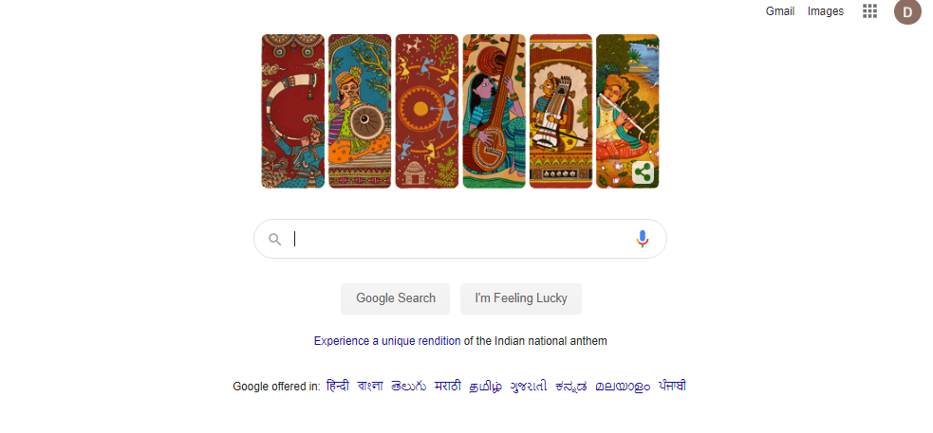
redirectServlet.java
import java.io.*;
import javax.servlet.*;
import javax.servlet.http.*;
public class redirectServlet extends HttpServlet
{
public void doGet(HttpServletRequest request,HttpServletResponse response)
throws ServletException,IOException
{
response.setContentType("text/html");
PrintWriter out=response.getWriter();
response.sendRedirect("http://www.google.com");
out.close();
} }
Servlet program to redirect Request to other URL

Slide 15
SendRedirect()
import java.io.*;
import javax.servlet.*;
import javax.servlet.http.*;
public class redirectServlet extends HttpServlet
{
public void doGet(HttpServletRequest request,HttpServletResponse response)
throws ServletException,IOException
{
response.setContentType("text/html");
PrintWriter out=response.getWriter();
response.sendRedirect("http://www.google.com");
out.close();
} }
Servlet program to redirect Request to other URL

Slide 16
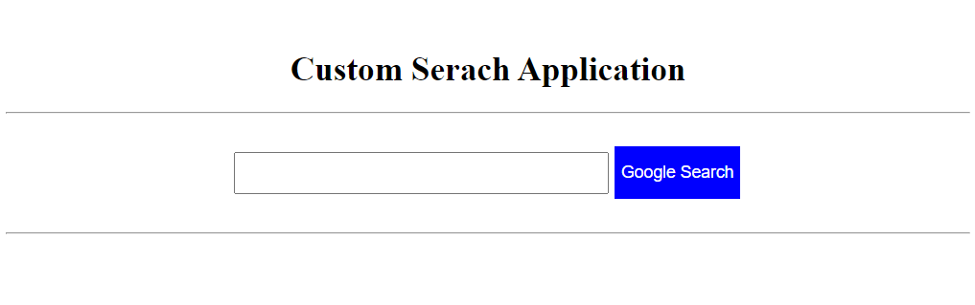
Servlet program for Custom Search
<html>
<head>
<title>sendRedirect example</title>
<style>
.button1{
background-color:blue;
color: white;
text-align: center;
font-size: 16px;
margin: 4px 2px;
Height:50px;
}
</style>
</head>
<body>
<form action="Search">
<br>
<center>
<h1> Custom Serach Application </h1>
<hr>
<br>
<input type="text" name="name" size=50 style="Height: 40px;"/>
<input class="button1" type="submit" value="Google Search" >
<br><br>
<hr></center>
</form>
</body>
</html>
<import java.io.*;
import javax.servlet.*;
import javax.servlet.http.*;
public class Search extends HttpServlet
{
protected void doGet(HttpServletRequest request, HttpServletResponse response)
throws ServletException, IOException {
String name=request.getParameter("name");
response.sendRedirect("https://www.google.co.in/#q="+name);
}
}

Slide 17

: sendRedirect()
In the sendRedirect method existing request and response objects are lost.
It happens on the client side.
request gets transferred to resource outside the application.
works on response object.
transfer to another resource to different domain.
sendRedirect method is slower because extra round trip is required because completely new request is created and old object request is lost.

Slide 18
RequestDispatcher in Servlet
The RequestDispatcher interface defines an object that receives the request from client and dispatches it to the resource(such as servlet, JSP, HTML file). This interface has following two methods:
RequestDispatcher has two methods:
Forward()
forwards a request from a servlet to another resource
Method
Include()
includes the content of a resource in the response

Slide 19
RequestDispatcher in Servlet
The RequestDispatcher interface defines an object that receives the request from client and dispatches it to the resource(such as servlet, JSP, HTML file). This interface has following two methods:
public void forward(ServletRequest request, ServletResponse response):
It forwards the request from one servlet to another resource (such as servlet, JSP, HTML file).
public void include(ServletRequest request, ServletResponse response):
It includes the content of the resource(such as servlet, JSP, HTML file) in the response.

Slide 20
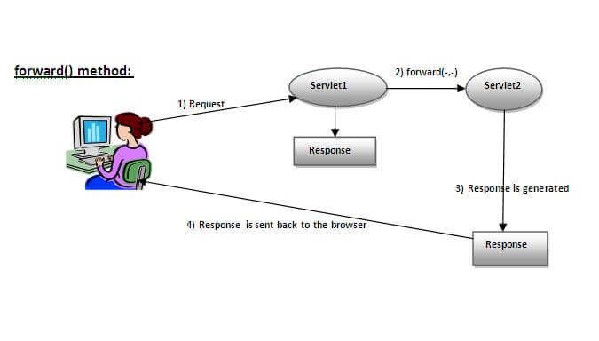
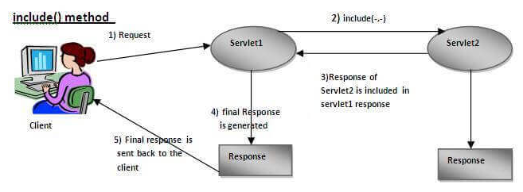
Difference between Forward() & include()
Response of second servlet is sent to the client. Response of the first servlet is not displayed to the user.
Response of second servlet is included in the response of the first servlet that is being sent to the client.
Source : https://www.javatpoint.com/

Slide 21
How to get the object of RequestDispatcher
getRequestDispatcher() method of ServletRequest interface returns the object of RequestDispatcher.
Syntax:
public RequestDispatcher getRequestDispatcher(String resource);
Example:
RequestDispatcher rd=request.getRequestDispatcher("servlet2");
//servlet2 is the url-pattern of the second servlet
rd.forward(request, response); //method may be include or forward

Slide 22
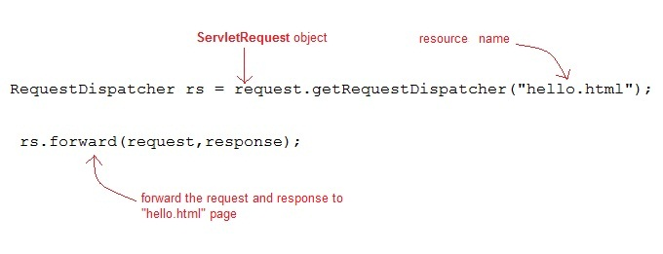
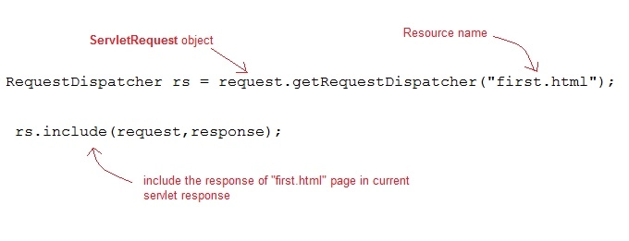
How to get the object of RequestDispatcher :example
Forward()
Include()

Slide 23
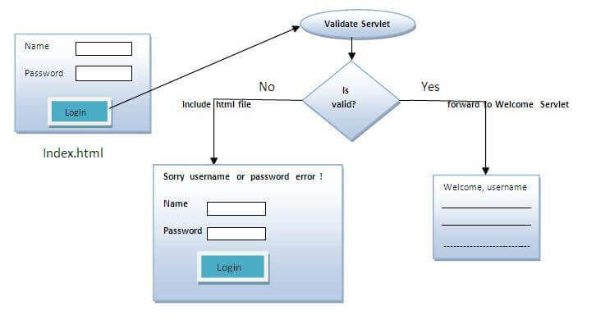
Implementation of login page
Design login page . Validating the password entered by the user. If password is valid , it will forward the request to the Welcome.java, otherwise will show an error message: sorry username or password incorrect…. Please try again!.
We will creat following files
index.html
Validate.java: a servlet class for processing the response. If password is valid, it will forward the request to the welcome servlet.
Welcome.java: a servlet class for displaying the welcome message.
web.xml file: a deployment descriptor file that contains the information about the servlet.

Slide 24
Implementation of login page
Validate.java
username=resquest.getParameter(“uname”)
Password = request.getParameter(pwd)
Index.html
name="uname“
name="pwd"
Invalid
Validation true
Welcome.java
Out.println( “welcome” + username)

Slide 25
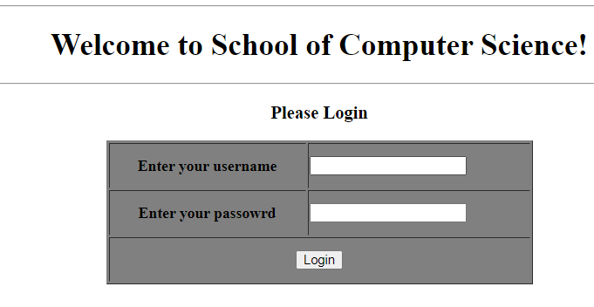
login.html
<html>
<body>
<body>
<form action="servlet1" method="post">
<center>
<hr>
<h1> Welcome to School of Computer Science! </h1>
<hr>
<h3> Please Login</h3>
<table width="445" height="150" border="1" bgcolor="gray">
<tr>
<th height="40">Enter your username</th>
<td>
<input type="text" />
</td>
</tr>
<tr>
<th height="40">Enter your passowrd</th>
<td>
<input type="password"/>
</td>
</tr>
<tr>
<th height="40" colspan="2">
<input type="submit" value="Login"/>
</th>
</tr>
</table>
</center>
</form>
</body> </html>

Slide 26
Validate.java
import java.io.*;
import javax.servlet.*;
import javax.servlet.http.*;
import javax.servlet.annotation.WebServlet;
@WebServlet(name = "welcome", urlPatterns = {"/Welcome"})
public class Validate extends HttpServlet {
public void doPost(HttpServletRequest request, HttpServletResponse response)
throws ServletException, IOException
{
response.setContentType("text/html");
PrintWriter out = response.getWriter();
String username=request.getParameter("uname");
String password=request.getParameter("pwd");
if(username.equals("admin") && password.equals("123"))
{
RequestDispatcher rd=request.getRequestDispatcher("Welcome");
rd.forward(request, response);
}
else{
out.print("Sorry UserName or Password Incorrect... Please try again..!");
RequestDispatcher rd=request.getRequestDispatcher("/index.html");
rd.include(request, response);
}
}
}
Use the @WebServlet annotation to define a servlet component in a web application.

Slide 27
Welcome1.java
import java.io.*;
import javax.servlet.*;
import javax.servlet.http.*;
public class Welcome1 extends HttpServlet
{
public void doPost(HttpServletRequest request, HttpServletResponse response)
throws ServletException, IOException
{
response.setContentType("text/html");
PrintWriter out = response.getWriter();
String username=request.getParameter("uname");
out.print("Welcome "+" " + username);
}
}

Slide 28
Web.xml
<web-app>
<servlet>
<servlet-name>loginpage </servlet-name>
<servlet-class> Validate </servlet-class>
</servlet>
<servlet-mapping>
<servlet-name>loginpage </servlet-name>
<url-pattern> /Validate </url-pattern>
</servlet-mapping>
<servlet>
<servlet-name>welcomepage </servlet-name>
<servlet-class> Welcome1 </servlet-class>
</servlet>
<servlet-mapping>
<servlet-name>welcomepage </servlet-name>
<url-pattern> /Welcome1 </url-pattern>
</servlet-mapping>
<welcome-file-list>
<welcome-file>index.html</welcome-file>
</welcome-file-list>
</web-app>

Slide 29
Web Annotation in Servlet
We have learnt how Servlet uses the deployment descriptor (web.xml file) for deploying your application into a web server.
Servlet API 3.0 has introduced a new package called javax.servlet.annotation.*
It provides annotation types which can be used for annotating a servlet class.
If you use annotation, then the deployment descriptor (web.xml) is not required. But you should use tomcat7 or any later version of tomcat.
Annotations can replace equivalent XML configuration in the web deployment descriptor file (web.xml) such as servlet declaration and servlet mapping.
Servlet containers will process the annotated classes at deployment time.
The annotation types introduced in Servlet 3.0

Slide 30
Web Annotation in Servlet :@WebServlet
The @WebServlet is used to declare the configuration of a Servlet with a container.
list of attributes used for WebServlet are
1 | String name Name of the Servlet
2 | String[] value Array of URL patterns
3 | String[] urlPatterns Array of URL patterns to which this Filter applies
At least one URL pattern MUST be declared in either the value or urlPattern attribute of the annotation
@WebServlet(name = "welcome", urlPatterns = {"/Welcome"})

Slide 31
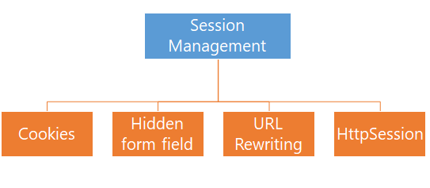
Session Management
HTTP is a stateless protocol.
All requests and responses are independent.
Sometimes we need to keep track of client's activity across multiple requests.
For eg. When a User logs into your website, not matter on which web page he visits after logging in, his credentials will be with the server, until he logs out. So this is managed by creating a session.
Session Management is a mechanism used by the Web container to store session information for a particular user.
When user starts using our application, we can save a unique identification information about him, in an object which is available throughout the application, until its destroyed.
Four different techniques used by Servlet application for session management.

Slide 32

Session Management
Server
Request
Id=123
Web Container
session
Id=123
client1
servlet
session
Id=231
Request
Id=321
client2

Slide 33
HttpSession
HTTP is a stateless protocol.
All requests and responses are independent.
Sometimes we need to keep track of client's activity across multiple requests.
For eg. When a User logs into your website, not matter on which web page he visits after logging in, his credentials will be with the server, until he logs out. So this is managed by creating a session.
Session Management is a mechanism used by the Web container to store session information for a particular user.
When user starts using our application, we can save a unique identification information about him, in an object which is available throughout the application, until its destroyed.
Four different techniques used by Servlet application for session management.

Slide 34
Difference Between GenericServlet
Generic Servlet
request
thread
client
server
Service()
response
https://www.studytonight.com/servlet/httpsession.php
https://beginnersbook.com/2013/05/http-session/

Slide 35
Auto Refresh Page : Using setIntHeader()
We can refresh the server in two ways
Through client side
and another through server side.
Consider situation where the webpage containing the live score of the match or any live activities we want to see in web page.
In such web page either refresh the web page or browse to know the current status.
Servlet can help to get the solution for this problem.
Refreshing A Servlet
We can refresh the web page by using setIntHeader() of response object
public void setIntHeader(String header, int headerValue)
Sends back header "Refresh" to the browser along with an integer value which indicates time interval in seconds.

Slide 36
Architecture Diagram:
Web Container
Servlet Class
Servlet Object
Load class
Servlet. class
Instantiation servlet
Servlet object
Initialization init(….)
Called only once & ServletConfig object is assigned servlet
service()
doGet() doPost()
Each request is separate thread
Called before destroying an object , Clean up code written here
destroy( )

Slide 37
<<Interface>>
javax.io.Serializable
+getInitParameter( )
+getServletContext( )
+getInitParameterNames( )
+getServletName( )
<<Interface>>
javax.servlet.ServletConfig
+getInitParameter( )
+getServletContext( )
+getInitParameterNames( )
+getServletName( )
+init( )
+getServletConfig( )
+service( )
+getServletInfo( )
+destroy( )
<<Interface>>
javax.servlet.ServletConfig
<<Interface>>
javax.servlet.Servlet
+init( )
+getServletConfig( )
+service( )
+getServletInfo( )
+destroy( )
+getInitParameter( )
+getServletContext( )
+getInitParameterNames( )
+getServletName( )
+log( )
javax.servlet.GenericServlet
+doGet( )
+doPost( )
+service( )
+doPut( )
+doTrace( )
+getLastModified( )
+doOptions( )
+doDelete( )
javax.servlet.HttpServlet
Basic Servlet

Slide 38
https://www.eclipse.org/downloads/download.php?file=/oomph/epp/2020-06/R/eclipse-inst-win64.exe

